Slide 1
UNIT-I

Slide 2
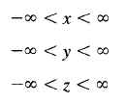
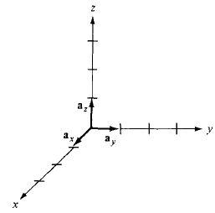
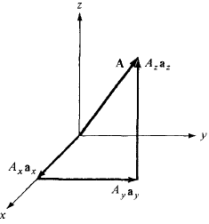
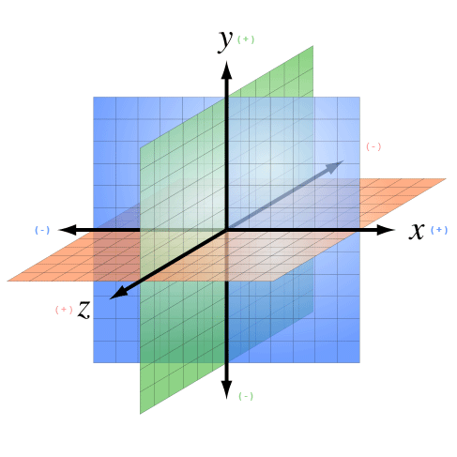
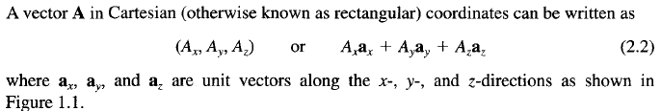
1. Cartesian Coordinate System
A point P is represented by (x,y,z)
The ranges of coordinate variable x,y,z are:
YZ-Plane
XY-Plane
ZX-Plane

Slide 3
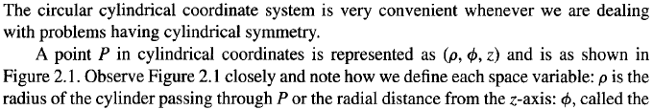
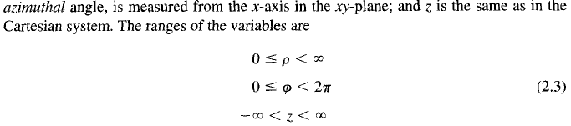

2. Circular Cylindrical Coordinate Systems and Transformation

Slide 4
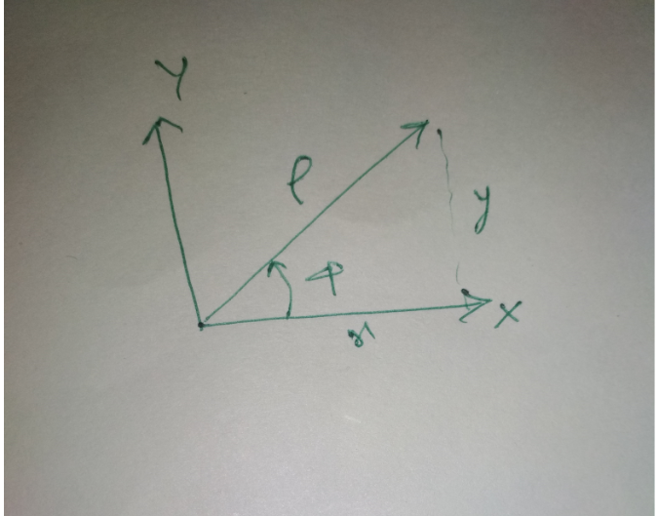

Slide 5
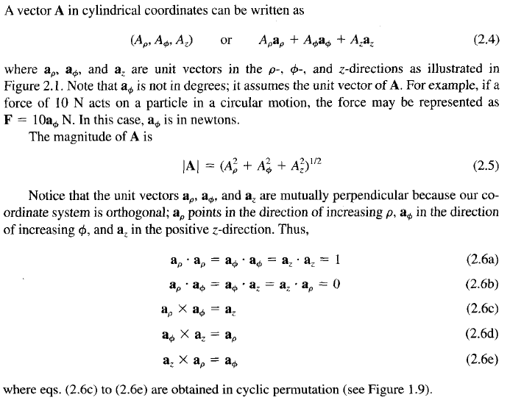
2. Circular Cylindrical Coordinate Systems and Transformation

Slide 7
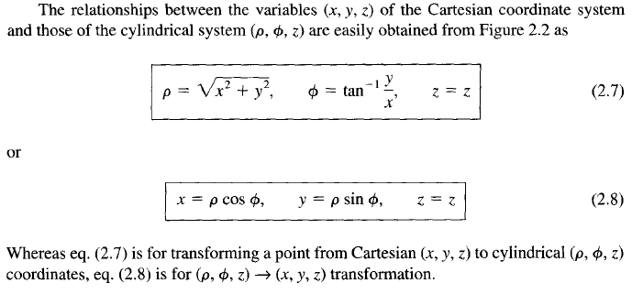
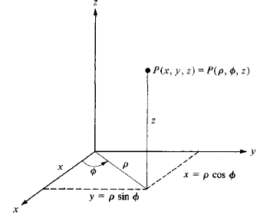

2. Circular Cylindrical Coordinate Systems and Transformation

Slide 8
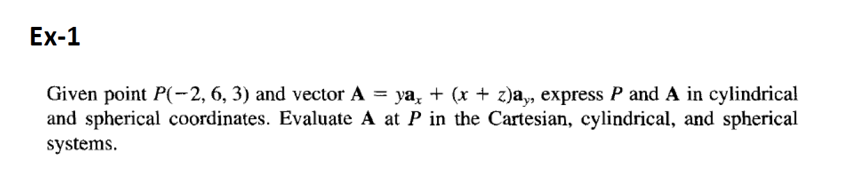

Slide 9
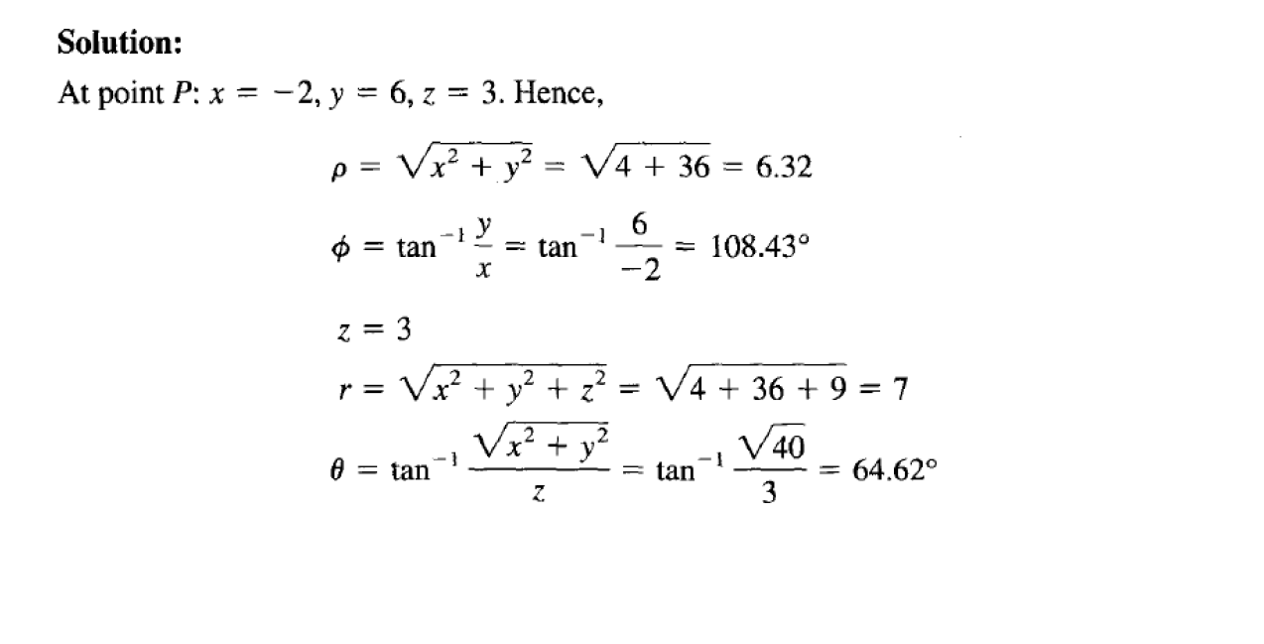

Slide 11
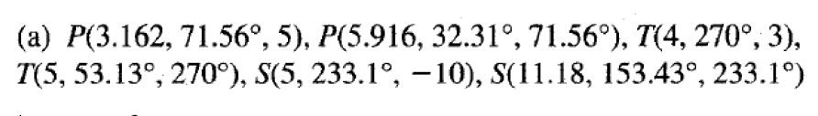

Slide 12
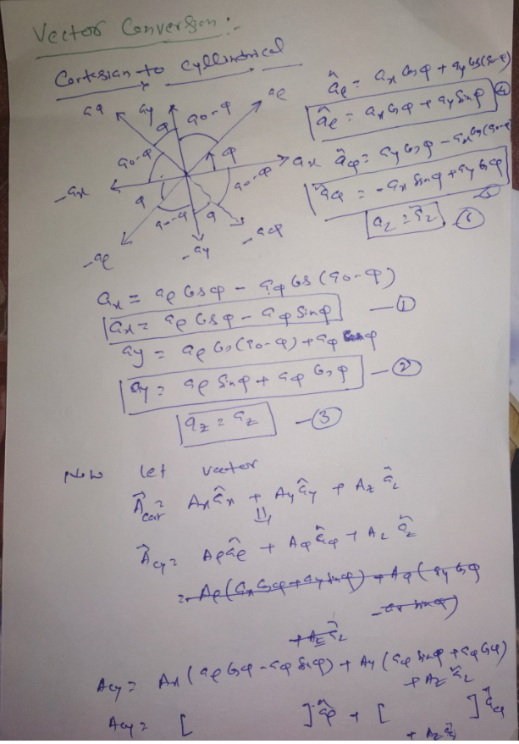

Slide 14
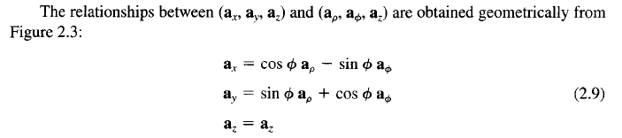


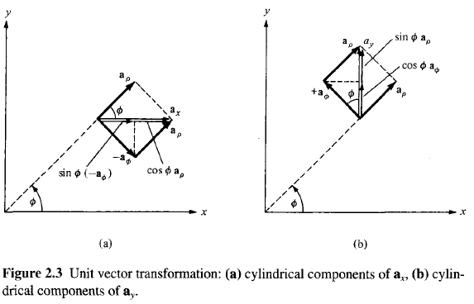
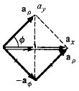
2. Circular Cylindrical Coordinate Systems and Transformation
(d)
(c)

Slide 15
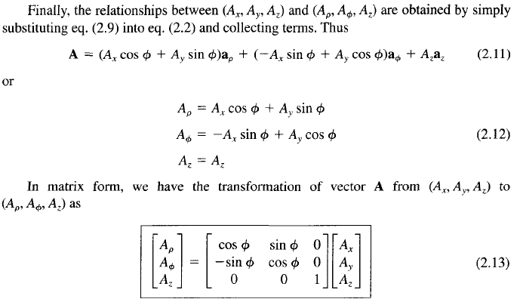
2. Circular Cylindrical Coordinate Systems and Transformation

Slide 16
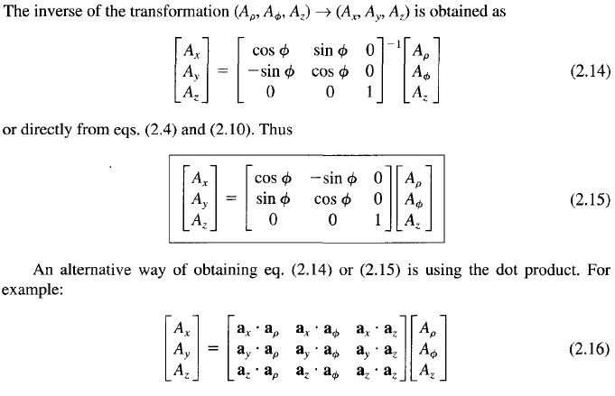
2. Circular Cylindrical Coordinate Systems and Transformation

Slide 17


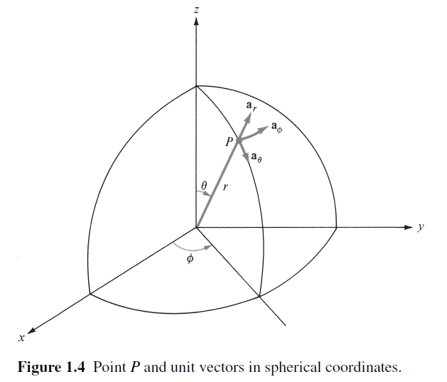

3. Spherical Coordinate System and Transformation
*Colatitude: the complement, in spherical coordinates, of a latitude (the difference between a latitude and 90 degrees)

Slide 18
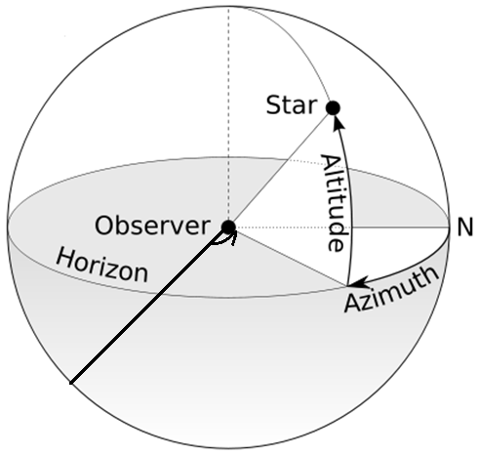
The Azimuth
An azimuth (from Arabic al-sumūt, meaning "the directions") is an angular measurement in a spherical coordinate system.
The vector from an observer (origin) to a point of interest is projected perpendicularly onto a reference plane; the angle between the projected vector and a reference vector on the reference plane is called the azimuth.

Slide 19
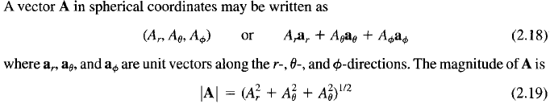
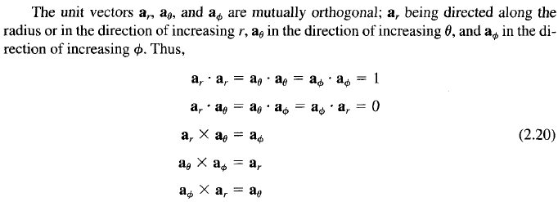
3. Spherical Coordinate System and Transformation

Slide 20
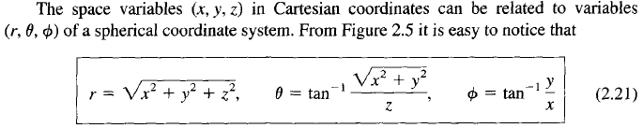
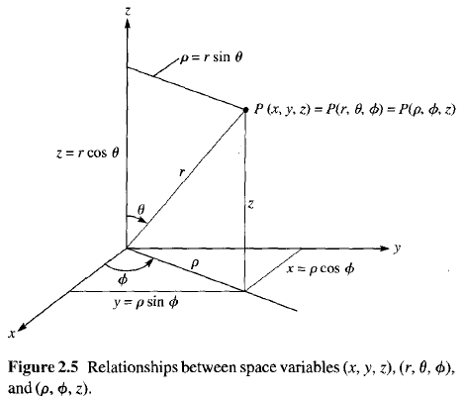
3. Spherical Coordinate System and Transformation

Slide 21
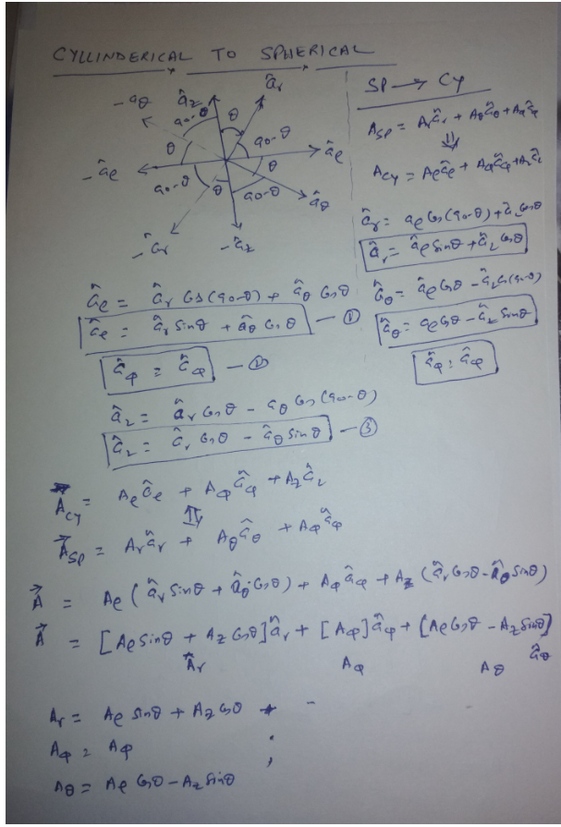

Slide 22
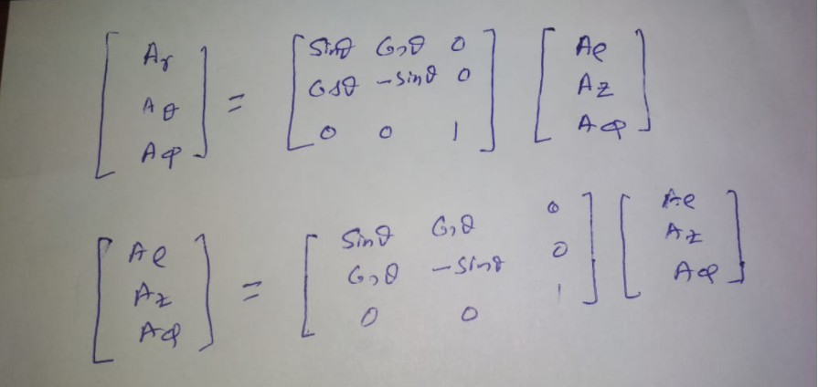

Slide 23
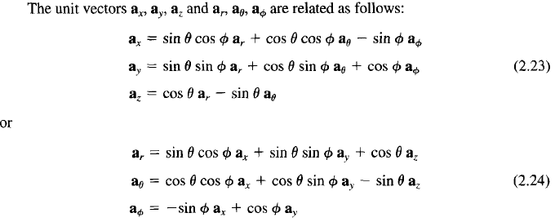


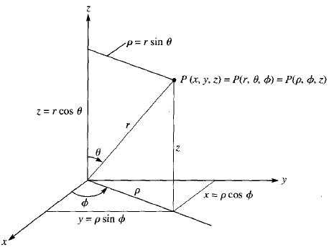
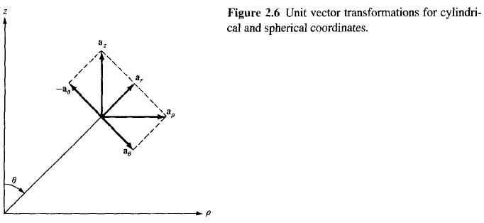
3. Spherical Coordinate System and Transformation

Slide 24
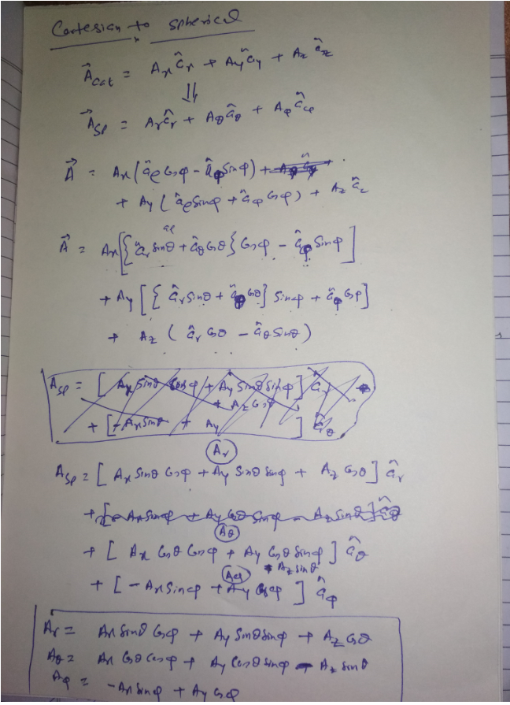

Slide 25
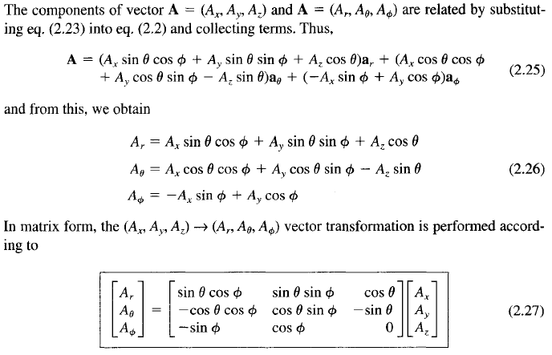
3. Spherical Coordinate System and Transformation

Slide 26
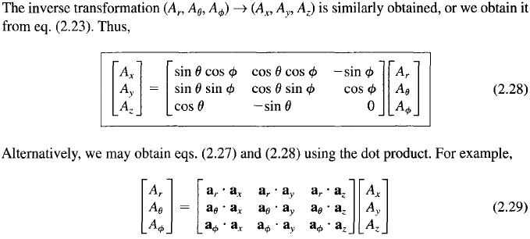
3. Spherical Coordinate System and Transformation

Slide 27
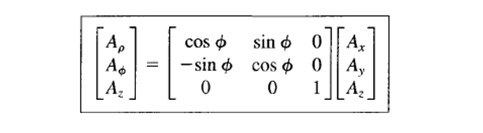

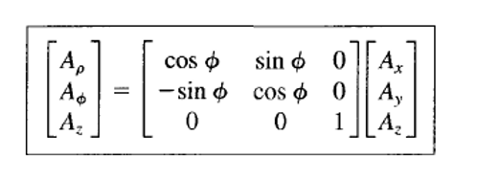
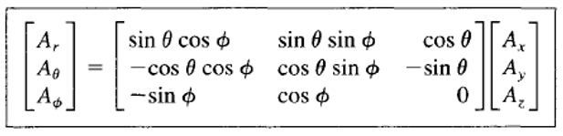

Slide 28
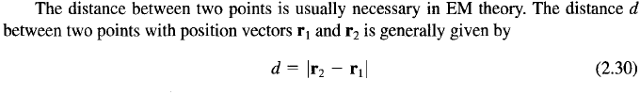
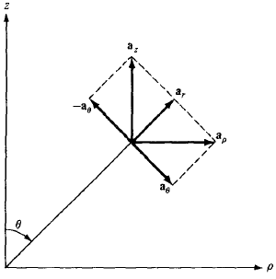
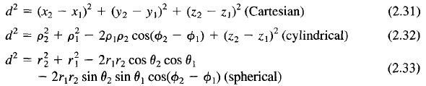

Distance Between Two Points

Slide 29
Thanks !

